Slide 1

DATA 410 – Assignment 3 Visualizing Data to Assist in Decision Making
Team Members that completed this assignment:
Flavio Akira
Hilary MacDonald
Wayne Yang

Slide 2
1 – Business Understanding –High Level
Notes:
For the High Level Business Understanding focus on the Case Study supplied.

Slide 3
Case Study
Global Climate Justice: https://cases.open.ubc.ca/global-climate-justice/

Slide 4
Introduction
The case study discusses the global issue of climate change and how we should approach the issue. Different levels of appropriate action should be considered, from individual to local to global.

Slide 5
Problem Solving Process 1 – Exploring the mess
# | Question | Answer
Q1.1 | What problems (or opportunities) did they face? | The problem with the most focus when concerning climate change is an increase in global temperature – the need to stay within 1.5 - 2 degrees of pre-industrial temperatures. This extends to additional problems such as: glacial melting/coastal erosion, water availability/distribution, disruption to the ecosystem, impact on food production, human health (pollution, spread of disease).
Q1.2 | Where was there a gap between the current situation and the desired one? | In the current situation, we have the Kyoto Protocol, United Nations Framework Convention on Climate Change (UNFCCC), and Paris Agreement. Due to the lack of cooperation between nations, they are not close to controlling the situation. The desired one focuses controlling the temperature and be more sustainable.
Q1.3 | What were the stated and unstated goals? | Stated Goals: Controlling climate change. Maintaining our global temperature below 2°C above the pre-industrial mean. Unstated Goals: Reducing global effects ( droughts, flooding, heat waves, cyclones, thunderstorms, wildfires, pollution and glacial melting). Public health: respiratory diseases.
Notes:
This step is complete when we have produced a satisfactory description of the situation and when we have identified (but not necessarily gathered) the key facts and data.

Slide 6
Problem Solving Process 2 – Searching for information
# | Question | Answer
Q2.1 | What were the symptoms and causes? | For this case study, the symptoms are the human influence on climate change (greenhouse gases, industrialization/urbanization). This causes not just a slight increase in temperature, but more drastic events such as: droughts, flooding, heat waves, cyclones, thunderstorms, and more.
Q2.2 | What measures of effectiveness seemed appropriate? | The easiest measure of effectiveness is to keep track of global temperature levels and maintain a clean database. Temperature can be measured locally or nationally/regionally, as well as land or water bodies.
Q2.3 | What actions were available? | Actions can be divided down to individual, local, or global. Individually we must create a culture/way of thinking that revolves around climate change. On a more global scale, actions include government policy. Government policy must coordinate with other nations to reach our international goals.
Notes:
This step is complete when we have found and organized relevant information for the situation at hand and when we have made some initial hypotheses about the source of the problem and potential solutions.

Slide 7
Problem Solving Process 3 – Identifying a problem
# | Question | Answer
Q3.1 | Which was the most important problem in this situation? | The problem with the most focus when concerning climate change is an increase in global temperature – the need to stay within 1.5 - 2 degrees of pre-industrial temperatures. This extends to additional problems such as: glacial melting/coastal erosion, water availability/distribution, disruption to the ecosystem, impact on food production, human health (pollution, spread of disease).
Q3.2 | Was the problem like others they had dealt with? | N/A
Q3.3 | What were the consequences of a broad versus narrow problem statement? | Broad: Countries relying on the global numbers and not holding themselves accountable for the part they have played. Narrow: Countries hyper-focusing on themselves rather than as a unified front globally. Only considering their actions and how their country will benefit/lose out. Essentially needs to be a happy-medium between the two.
Notes:
This step is complete when we have produced a working problem statement.

Slide 8
Problem Solving Process 4 – Searching for solutions
# | Question | Answer
Q4.1 | What decisions were open to them? | Many individuals, local and global. The government's decision is required, but governments are reluctant because it impacts directly negatively on their economics.
Q4.2 | What solutions had been tried in similar situations? | Multiple conferences have tried to address and are currently addressing climate change. However, due to lack of cooperation between all nations, we have not seen the intended goals met.
Q4.3 | How did the various candidate solutions link to the outcomes of interest? | They all converge to: an economic problem / sustainable growth/ pollution/ climate change.
Notes:
This step is complete when we have produced a list of potential solutions and perhaps a list of advantages and disadvantages for each one.

Slide 9
Problem Solving Process 5 – Evaluating solutions
# | Question | Answer
Q5.1 | How did the solution impact each of the criteria? | The Kyoto Protocol, United Nations Framework Convention on Climate Change (UNFCCC), and Paris Agreement are all international meetings made by nations to address the issue. Goals and agreements are set at these meetings to help control the human influence on climate change. It is not stated in this case study if all targets have been met in reducing global temperature increase.
Q5.2 | What factors within their control could have improved the outcomes? | All factors are within our control as our objective is to reduce the human influence on climate change. Some argue that a transition to a less carbon-intensive economy is feasible, however, this requires the coordination of all nations. It is also important to note that powerful corporations with investments in carbon-based economies influence governments.
Q5.3 | What factors outside their control could have altered the outcomes? | With our technology and society today, we will have to still rely on carbon-based materials for our way of life and survival. It is impossible to eliminate greenhouse gases instantaneously. However, this factor can be minimized through changing our levels of actions on an individual, local, and global scale.
Notes:
This step is complete when we have produced a recommended course of action, along with justification that supports it.

Slide 10
Problem Solving Process 6 – Implementing a solution
# | Question | Answer
Q6.1 | What were the barriers to successful implementation? | Global unity and personal accountability. Countries would initially be on board for new protocols/agreements, then would rescind their support when it no longer suited their needs.
Q6.2 | Where was there support and motivation, or resistance and conflict? | Initial support and motivation appears to be strong at the beginning of a new protocol/agreement. Resistance and conflict appears later as the date for countries to reduce emissions/be held accountable approaches.
Q6.3 | Were there resources available for successful implementation? | The resources (ie: information and available technology) are readily available for successful implementation. The issues lie on the global political front, not the scientific community.
Notes:
This step is complete when we have produced an implementation plan and executed enough of it to begin evaluating how well it is succeeding.

Slide 11
2 – Data Understanding – High Level

Slide 12

Data Modeling – Conceptual Model
Natural Events
Drought
Flooding
Heat Waves
Cyclones/Hurricanes
Wildfires
Thunderstorms
Glacier Melting/Erosion
Water Availability
Ecosystem Disruption
Slower Food Production
Human Health
Individual Psychology
Ideology
Psychology
Confrontation
Delayed Benefits
Climate Change
Temperature
Human Influence
Industrialization
Urbanization
Greenhouse Emissions
Political Philosophy
Differentiated Responsibility
Fairness
Mitigation
Levels of Action
Individual
Local (Provincial/State)
Global (Federal)
Protocols
Kyoto Protocol
Paris Agreement
UNFCCC

Slide 13
Data Dictionary
No | Topic | Definition
1 | Climate Change | The increase in temperature globally driven by greenhouse gases.
2 | Human Influence | The result of human activities such as industrialization and urbanization causing the increase in greenhouse gas emissions.
3 | Industrialization | The reorganization of an economy to be based on mass manufacturing and production.
4 | Urbanization | The increase in people living in urban areas rather than rural. This results in a higher demand in resources per capita.
5 | Temperature | The global mean temperature is a primary measure of climate change. It is important to keep track of global temperatures to see how it progresses.
6 | Events | A natural sequence that happens that may be intensified by climate change such as natural disasters (droughts, flooding, heat waves, cyclones, wildfires, etc.)
7 | Conference | A meeting between world leaders to discuss issues.
8 | Kyoto Protocol | An international agreement part of the UNFCCC to reduce greenhouse gas emissions between nations.
9 | Paris Agreement | An international agreement part of the UNFCCC to manage the global temperature to below 2°C above pre-industrial averages.
10 | UNFCCC | United Nations Framework Convention on Climate Change. The division of the United Nations focusing on the reduction of climate change and emission of greenhouse gases.
11 | Political Science | Deals with knowledge surrounding systems of government and analyzes political activity and behavior.
12 | Government Policy | A rule or principle with a goal of bettering decisions, resulting in positive outcomes that enhance the intended community.
13 | Carbon-Based Economies | Countries whose economies are positively impacted by carbon emitting industries (ie: fossil fuels).
14 | Less Carbon-Intensive Economies | Economy based on low-carbon power sources, meaning minimal output of greenhouse gas emissions into the atmosphere.
15 | Political Philosophy | The philosophical study of government. Addresses questions about the nature, scope, and legitimacy of public agents/institutions and the relationship between them.

Slide 14
Data Dictionary
No | Topic | Definition
16 | Respiratory diseases | respiratory diseases like chronic obstructive pulmonary disease, asthma , and lung cancer.
17 | Global effects | Something that cause impact all parts of the world.
18 | Fossil fuels | Petroleum, natural gas, oil and heavy oils. All contain carbon and were formed because of geologic processes acting on the remains of organic matter produced by photosynthesis

Slide 15
1 (Revisited) – Business Understanding – Low Level

Slide 16
Business Question
Have land temperatures of the G7 countries increased at a similar rate over the last 100 years compared to the average global temperature?

Slide 17
2 (Revisited) – Data Understanding – Low Level

Slide 18
Data Set(s)
GlobalLandTemperatures_GlobalLandTemperaturesByCountry.csv
GlobalLandTemperatures_GlobalLandTemperaturesByMajorCity.csv
GlobalLandTemperatures_GlobalLandTemperaturesByState.csv
GlobalLandTemperatures_GlobalTemperatures.csv
Reference Link:
https://cases.open.ubc.ca/global-climate-justice/
Notes:
Candidate Data Sets available on Brightspace D2L:
GlobalLandTemperatures_GlobalLandTemperaturesByCountry.csv
GlobalLandTemperatures_GlobalLandTemperaturesByMajorCity.csv
GlobalLandTemperatures_GlobalLandTemperaturesByState.csv
GlobalLandTemperatures_GlobalTemperatures.csv

Slide 19
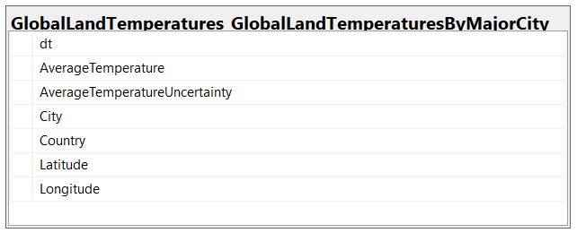
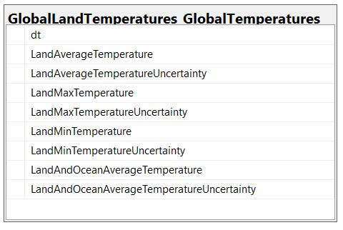
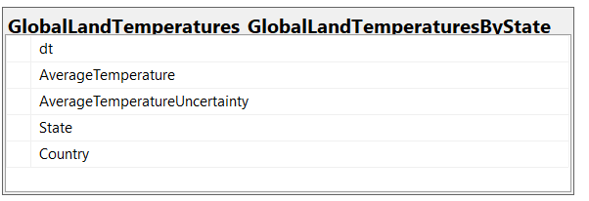
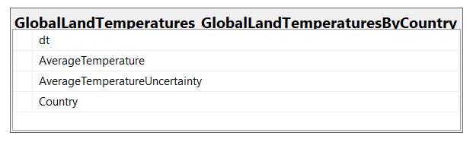
Database Diagram – Tables and Columns
To answer our business question, we will be using the data sets: GlobalLandTemperaturesByCountry and GlobalTemperatures
Notes:
Load the Data Set into SQL Server.
Use the SQL Server Management Studio (SSMS) Diagramming tool to produce the Database Diagram.

Slide 20
3 – Data Preparation

Slide 21
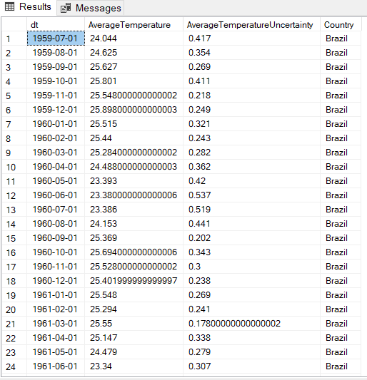
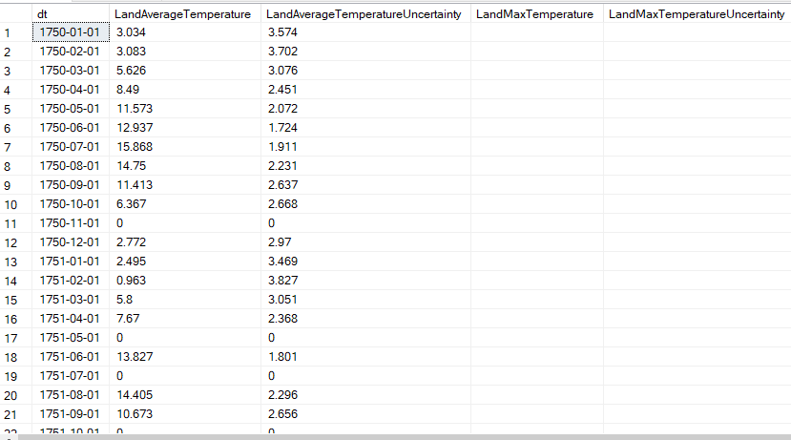
Data Preparation – Data cleansing
Original Source:
GlobalLandTemperatures_GlobalLandTemperaturesByCountry
Original Source:
GlobalLandTemperatures_GlobalTemperatures
Notes:
Document any data cleansing that was required, any quality issues encountered with the data.

Slide 22
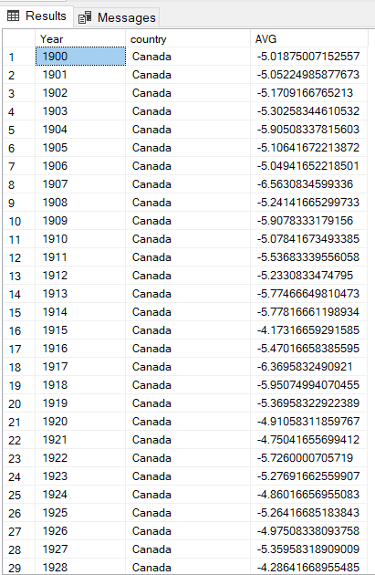
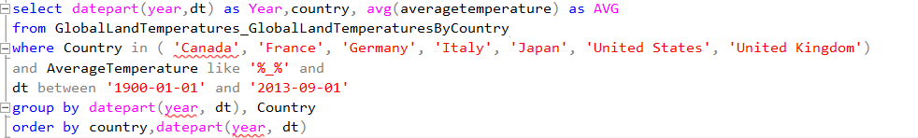
Data Preparation – SQL Query
Notes:
Use the SQL Server Management Studio (SSMS) tool to produce the SQL Query.
In this slide provide the SQL Query in text format, not screen shot format.

Slide 23
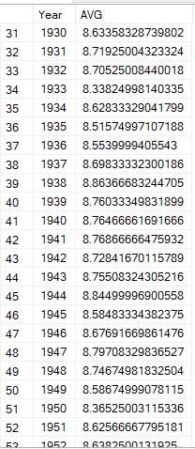
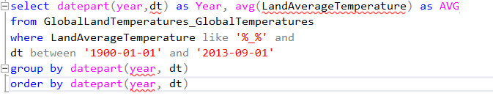
Data Preparation – Data set returned from Query
Notes:
Use the SQL Server Management Studio (SSMS) tool to return the results of the SQL Query.
In this slide have a screen shot of the results.

Slide 24
4 – Modeling

Slide 25
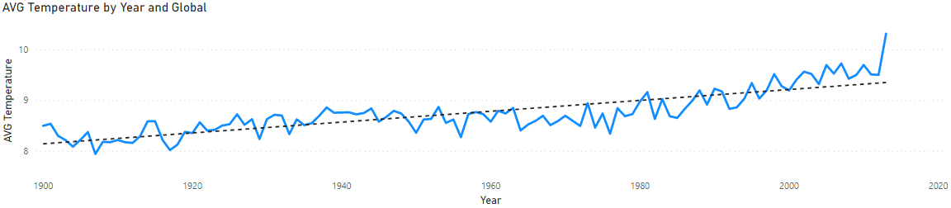
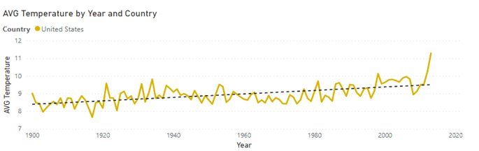
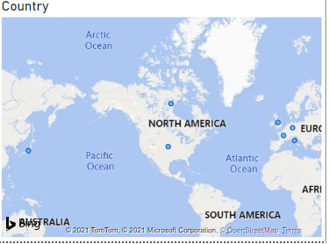
Visualization
Notes:
Provide a screen shot of the visualization built in Power BI or Tableau.

Slide 26
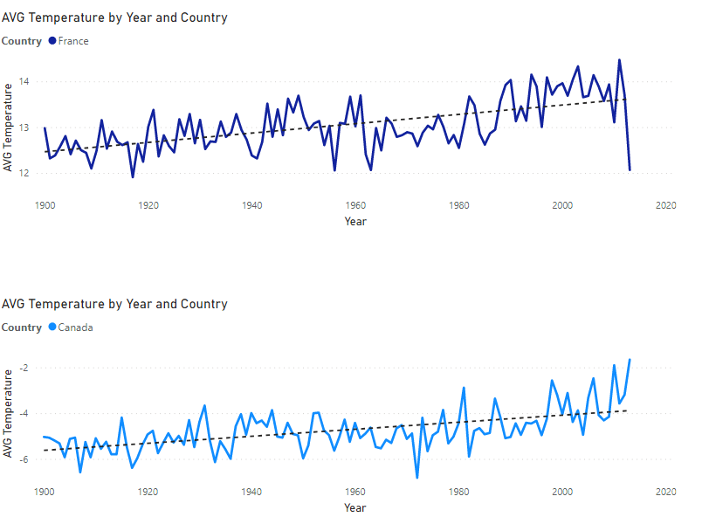
Notes:
Provide a screen shot of the visualization built in Power BI or Tableau.

Slide 27
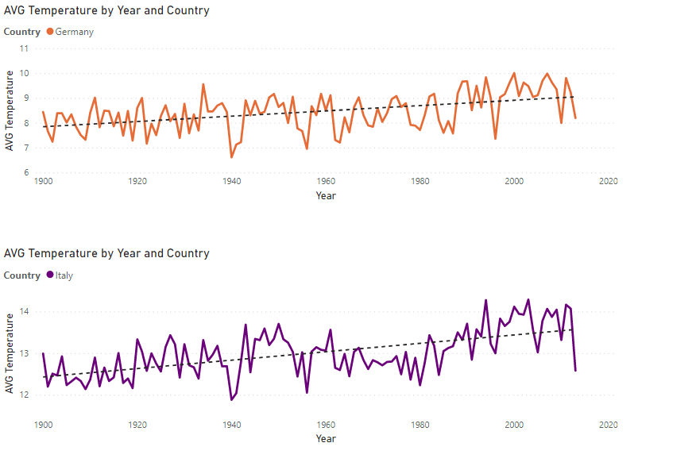

Slide 28
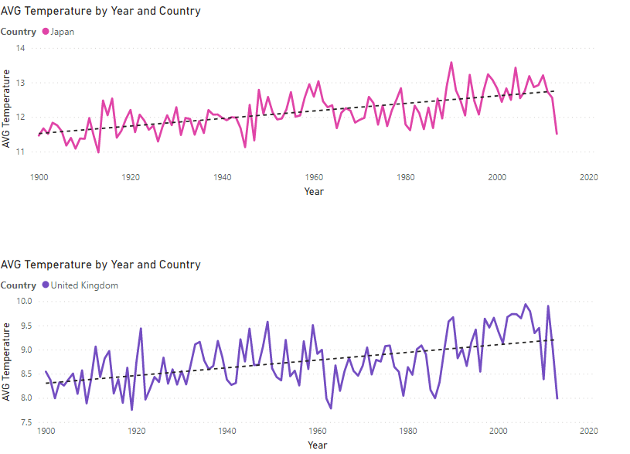

Slide 29
5 – Evaluation

Slide 30
Conclusion – Answer to Question
We can see that the global temperature has risen over the last 100 years along with each of the G7 countries. Each country's average land temperature has risen at a similar rate (by observing the trend line).
This tells us that the issue of climate change is global and not restricted by nation. The actions of a nation affect the whole planet.
Notes:
The answer to the question from Slide 15 needs to be supported by the data visualized in the previous steps.

Slide 31
Conclusion – Answer to Question
However, we have only looked at the G7 countries, which have some of the highest industrialization and urbanization. Further analysis must be done on less industrialized/urbanized countries to see if their increase in temperature is slower.
Another assumption made is that all G7 countries are in the northern hemisphere, and mainly in two continents (North America and Europe). A wider geographical distribution of countries can be analyzed for further insight.
Notes:
The answer to the question from Slide 15 needs to be supported by the data visualized in the previous steps.

